Slide 1

VITA SA App
Training for Trainers

Slide 2
Why an App?
Improve client experience
Reduced wait times
Provide feedback
Improve volunteer experience
Go where they are most needed
Provide suggestions
How:
Focus volunteers on sites that need and can use help
Client: Visibility to sites and support options (MFT, Express, etc.)
Site Coordinators are key: they maintain the site calendar, site features, and site eFiler requirements

Slide 3
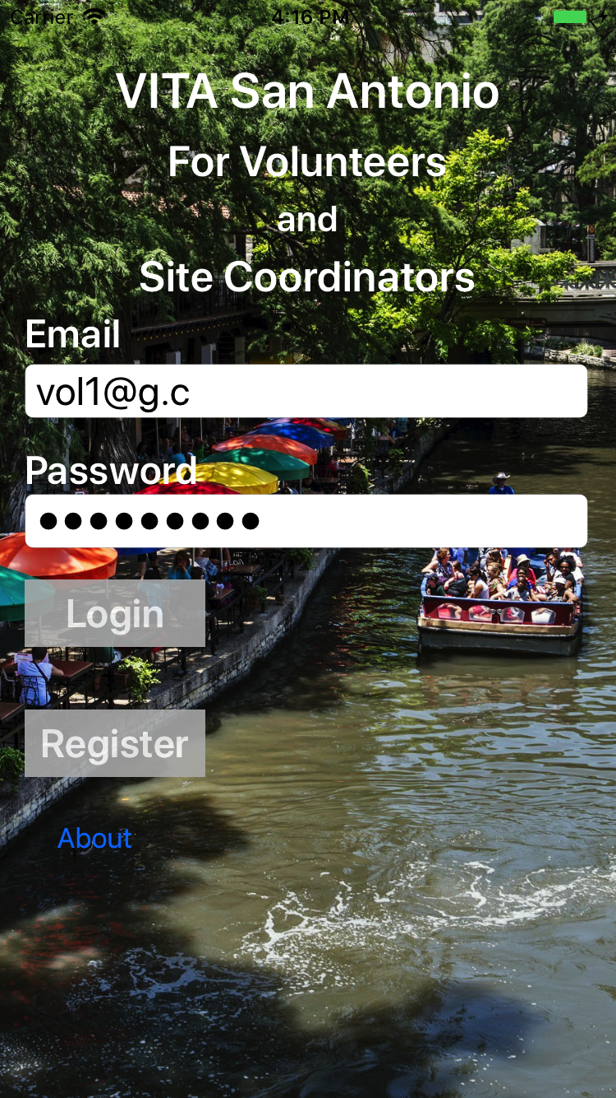
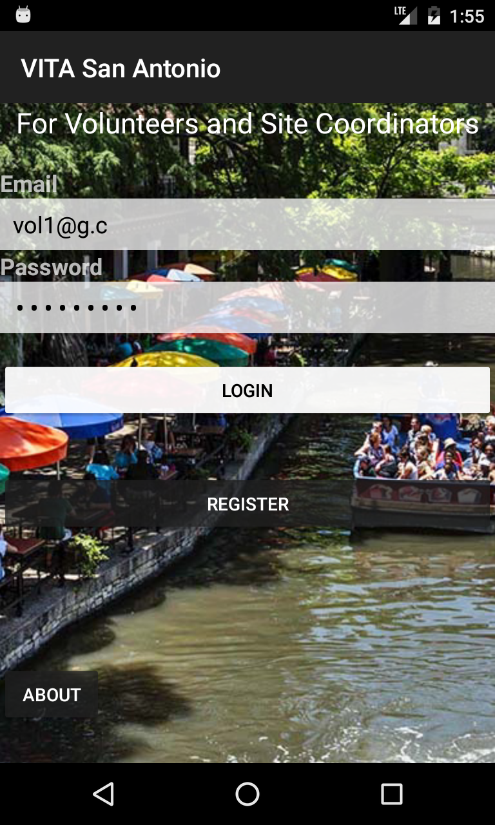
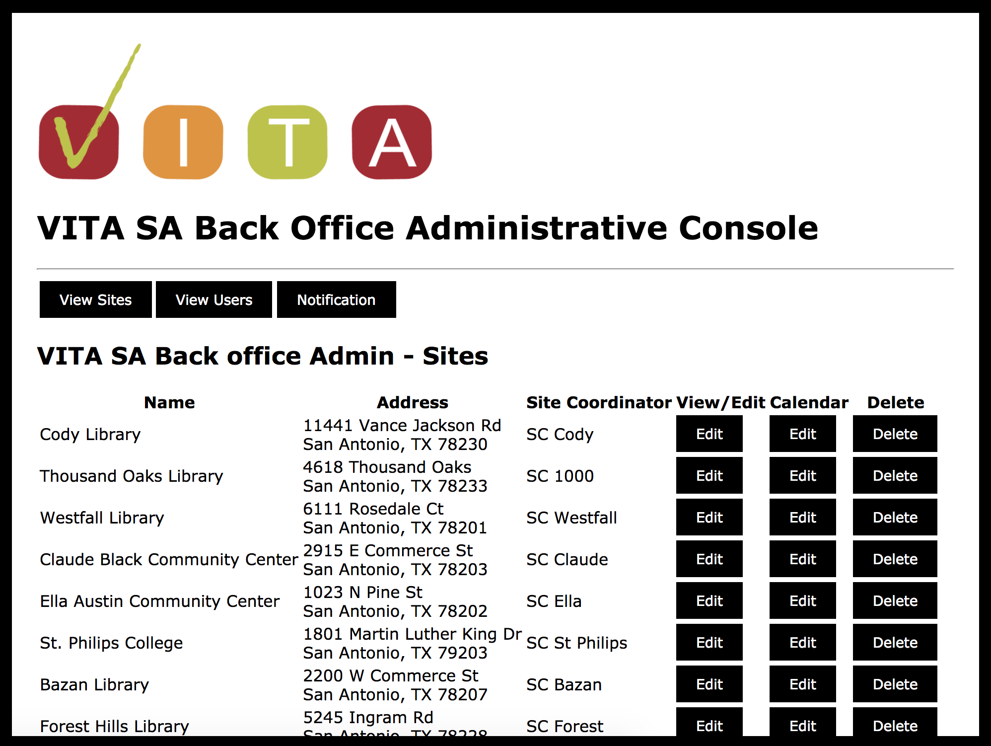
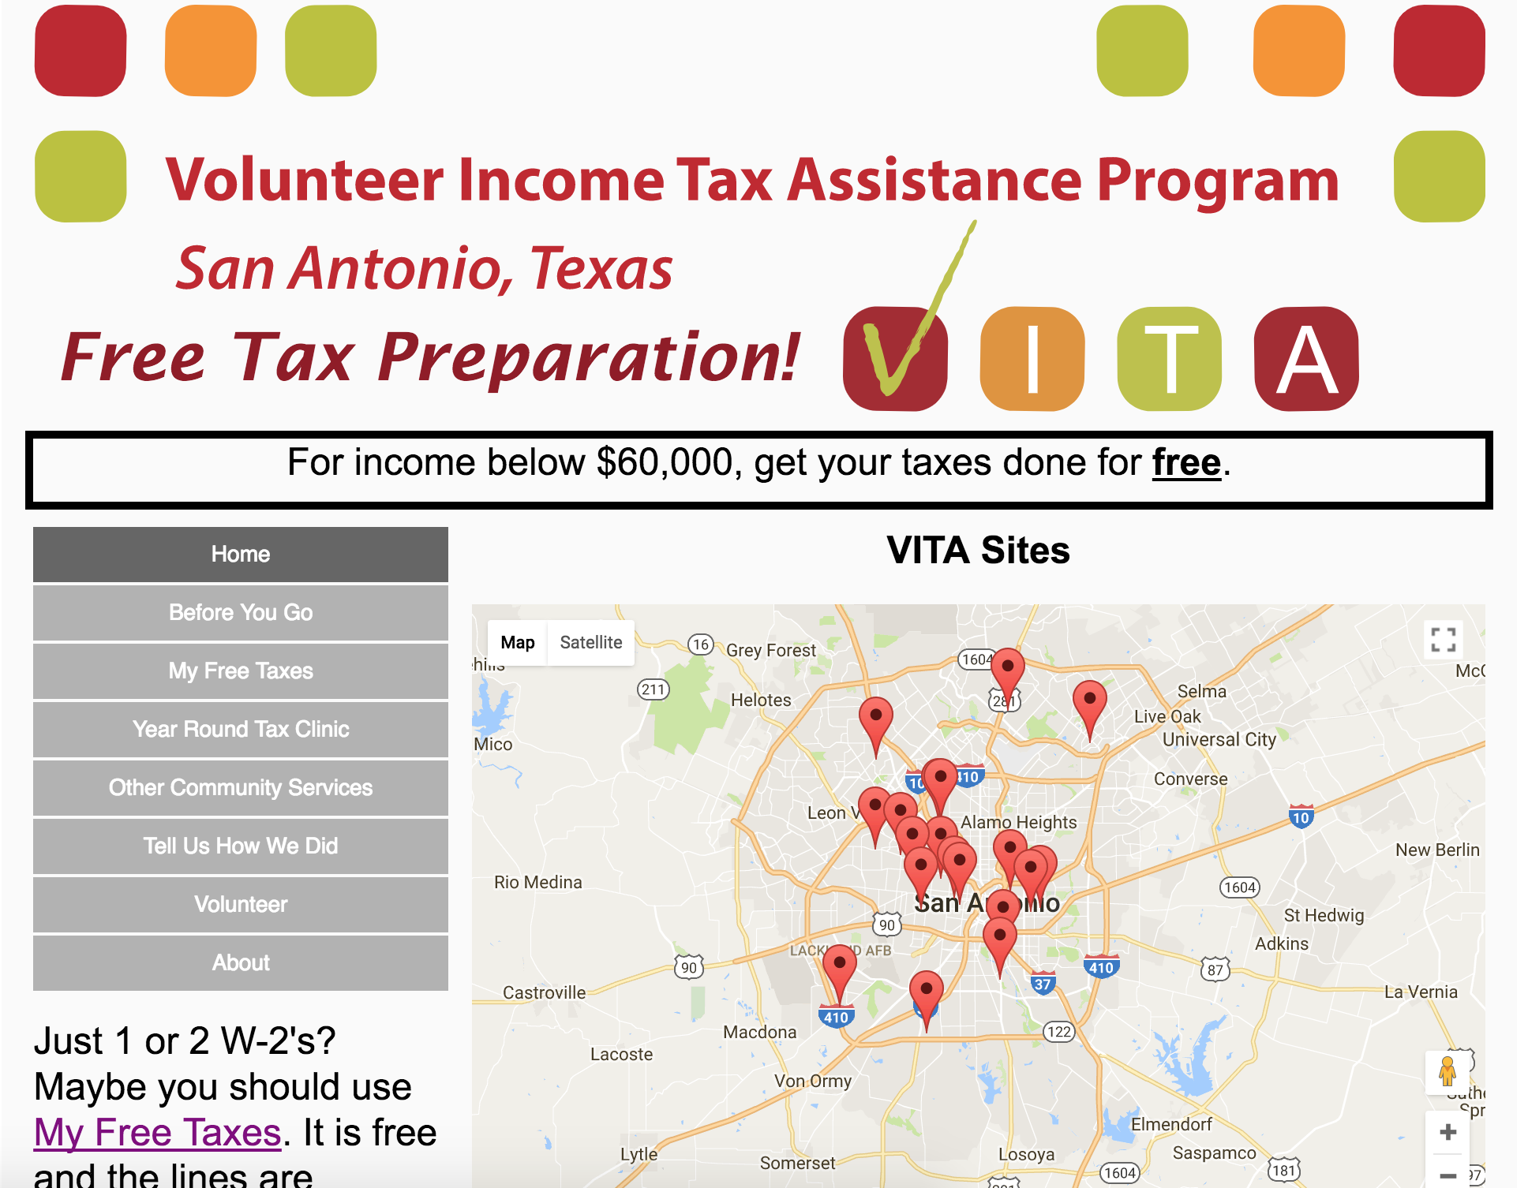
VITA SA App and Website
BackEnd
DB
iOS Devices
Android Devices
vitasa.org
(English and Spanish)
Back office administration
Client web and mobile

Slide 4
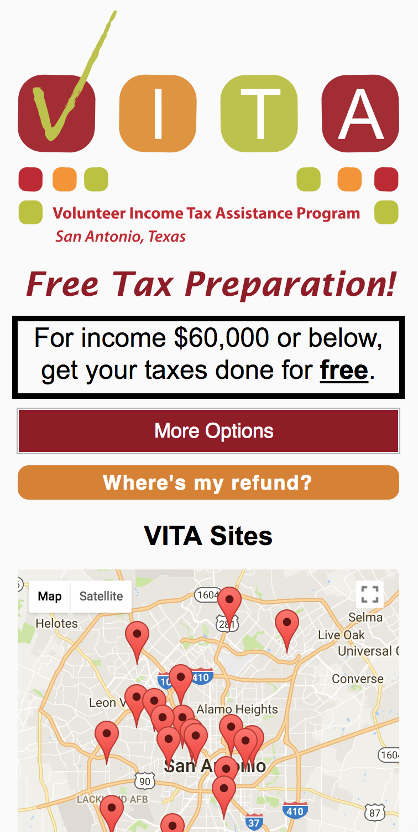
vitasa.org - Clients
Try it out: vitasa.org/en
Complete overhaul of vitasa.org
Home page: map of sites and guidance on what to bring
Why use VITA
List of VITA sites, address, and services
My Free Taxes: map and instructions
Year Around Tax Clinic: locations and services
Community services: list and services
Client feedback form
Contact Us: Alejandra and Sheila
Volunteers: why and how to volunteer
(Spanish and English)

Slide 5
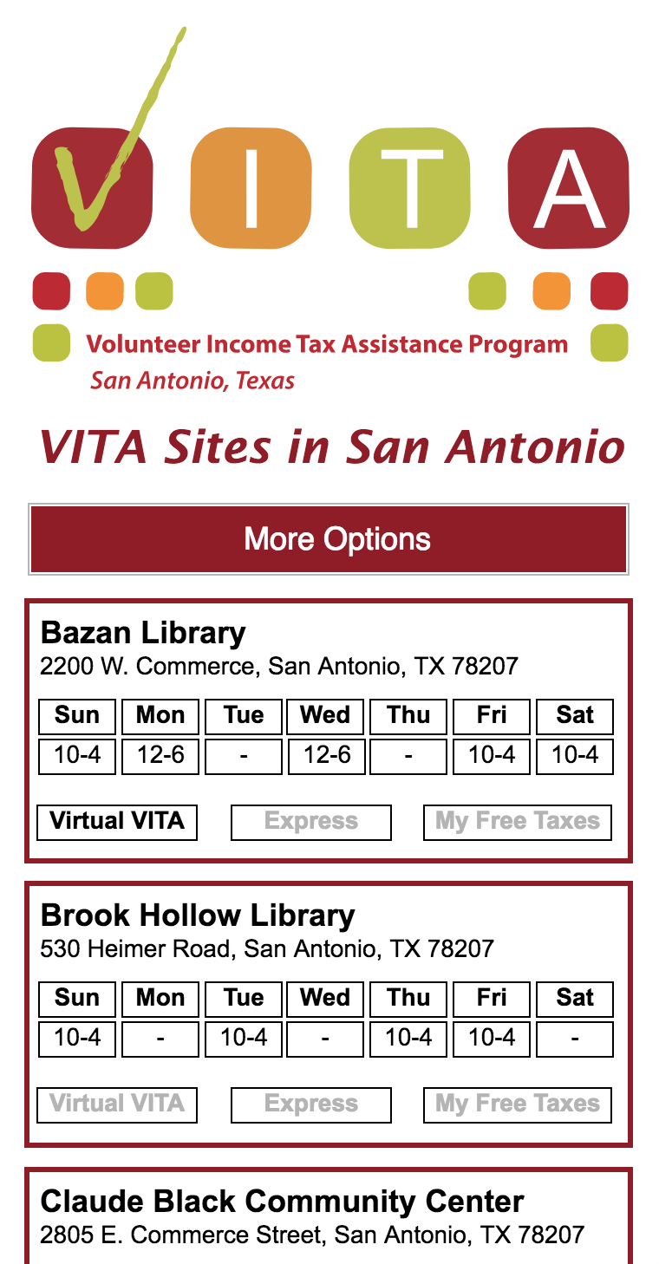
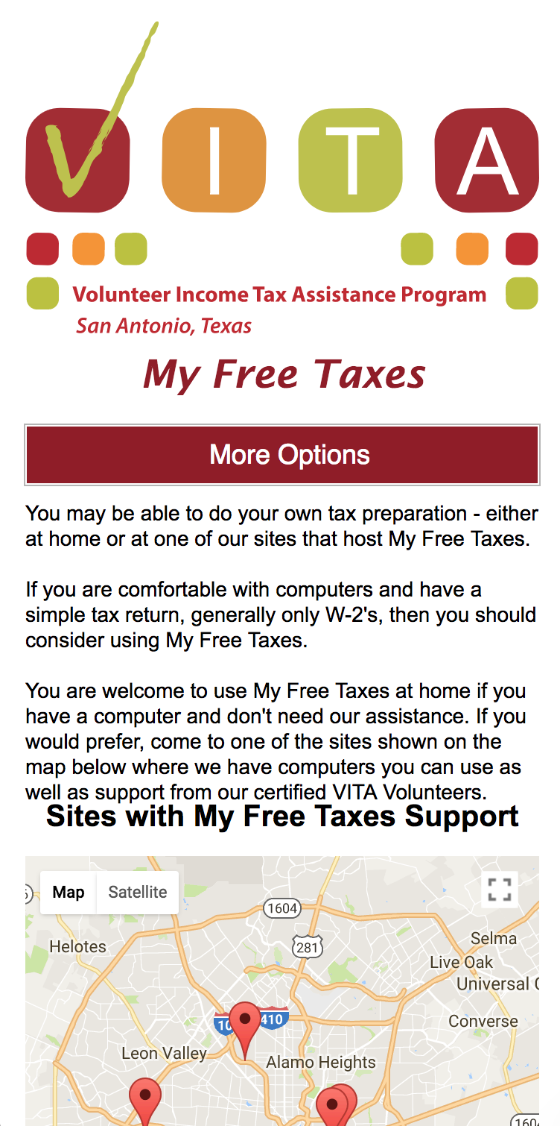

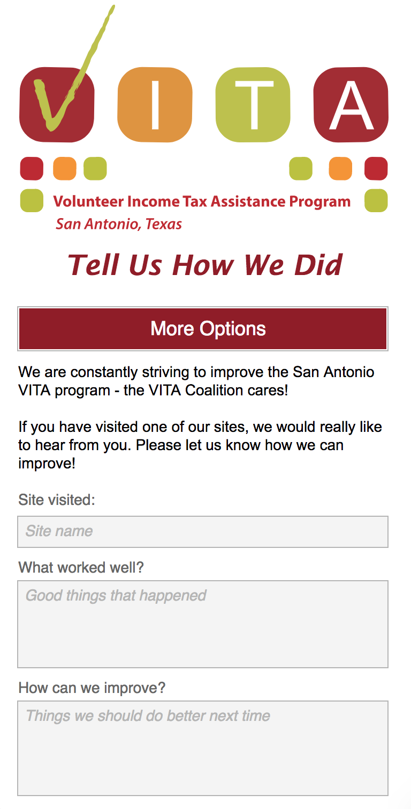
vitasa.org - Clients
Try it out: vitasa.org/en

Slide 6
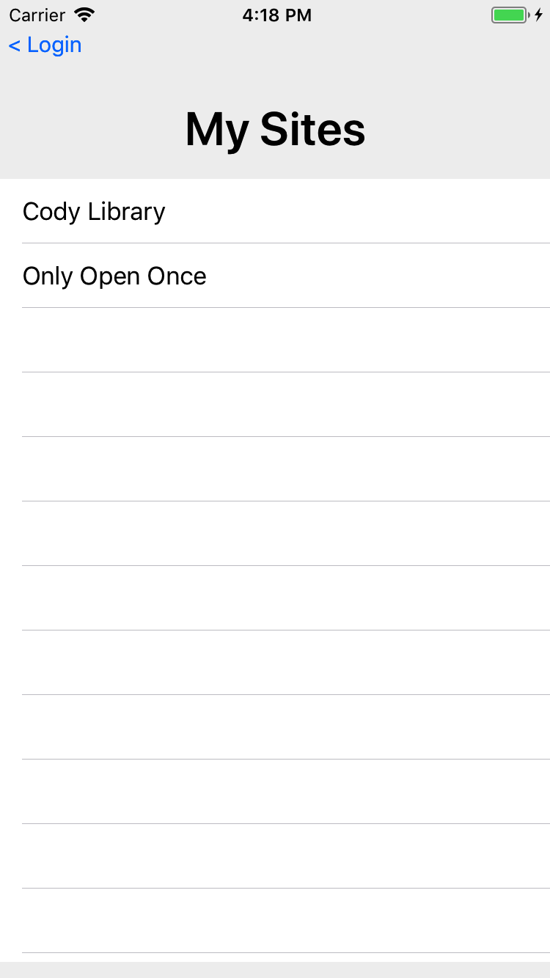
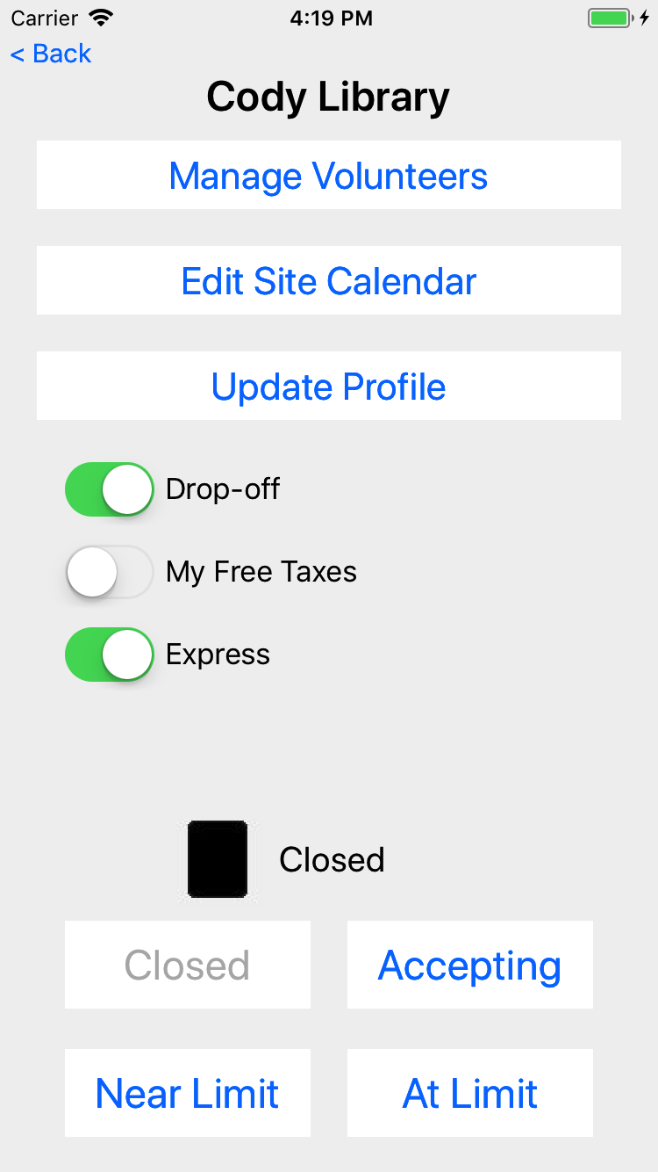
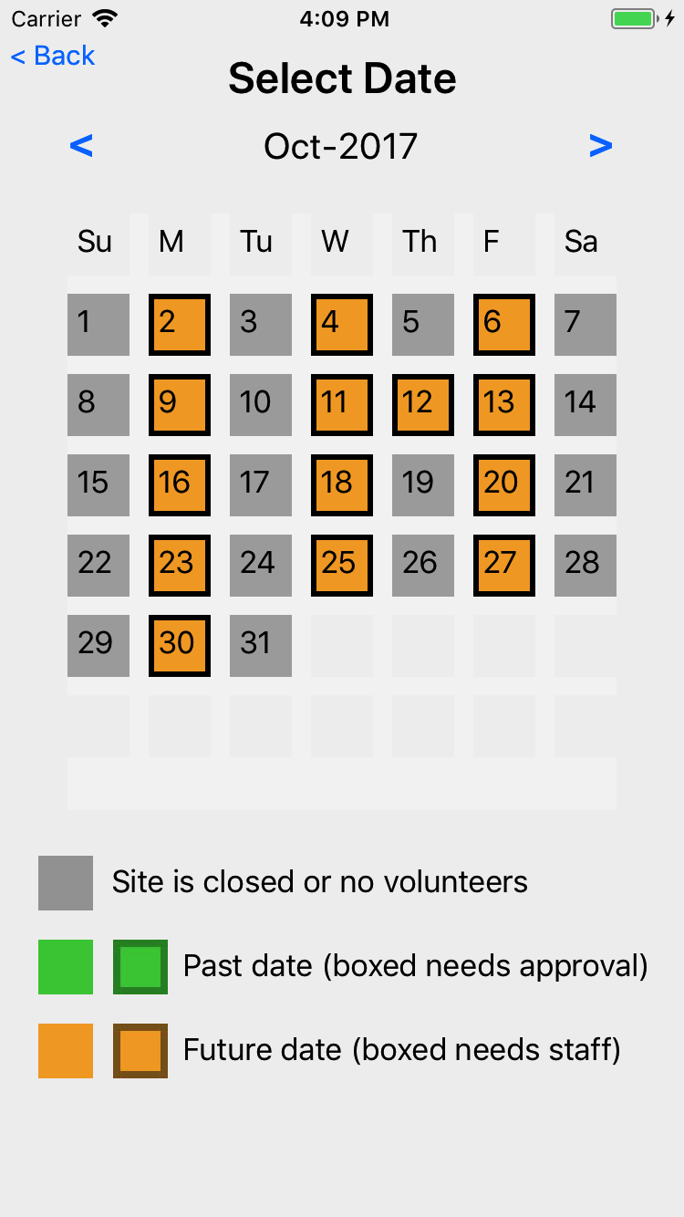
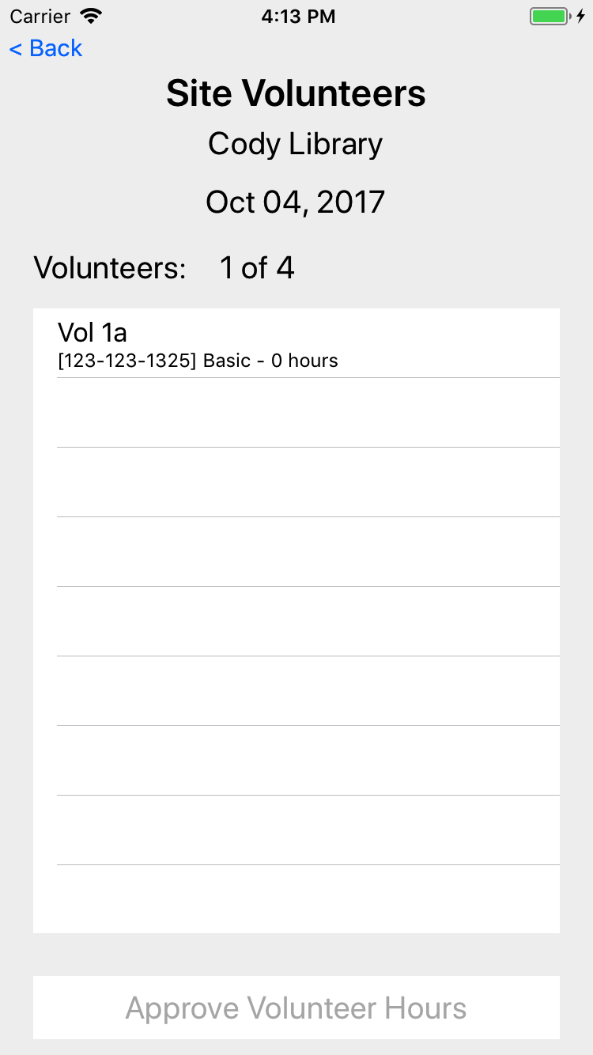
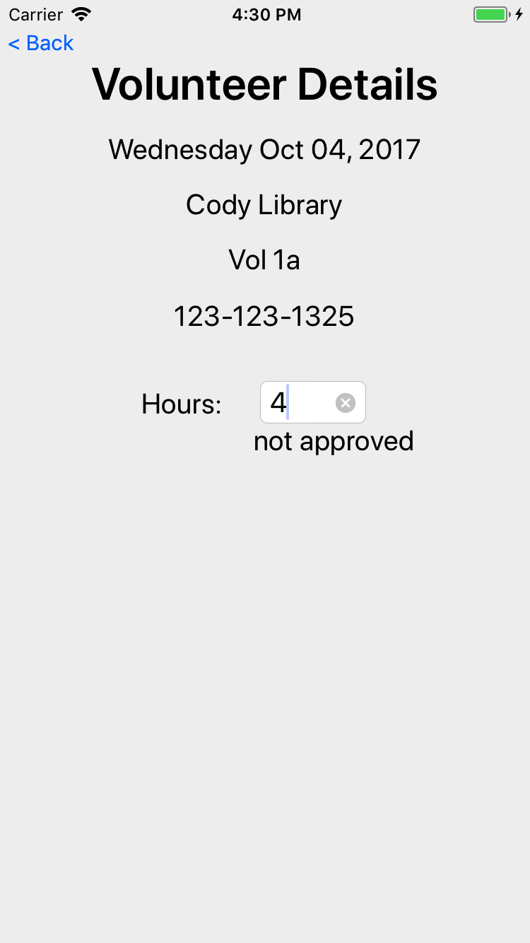
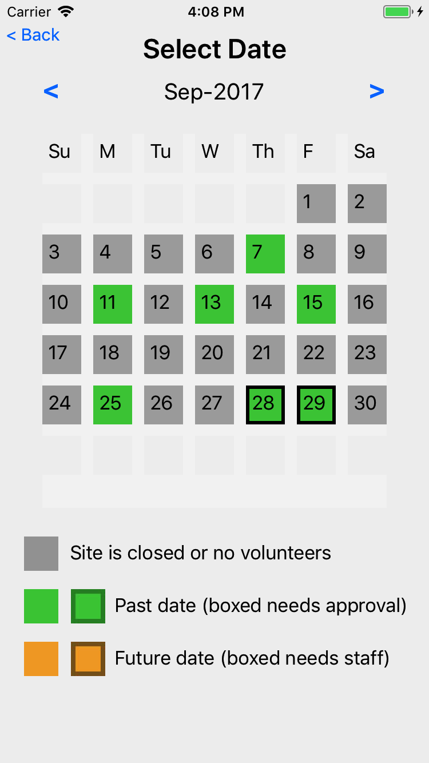
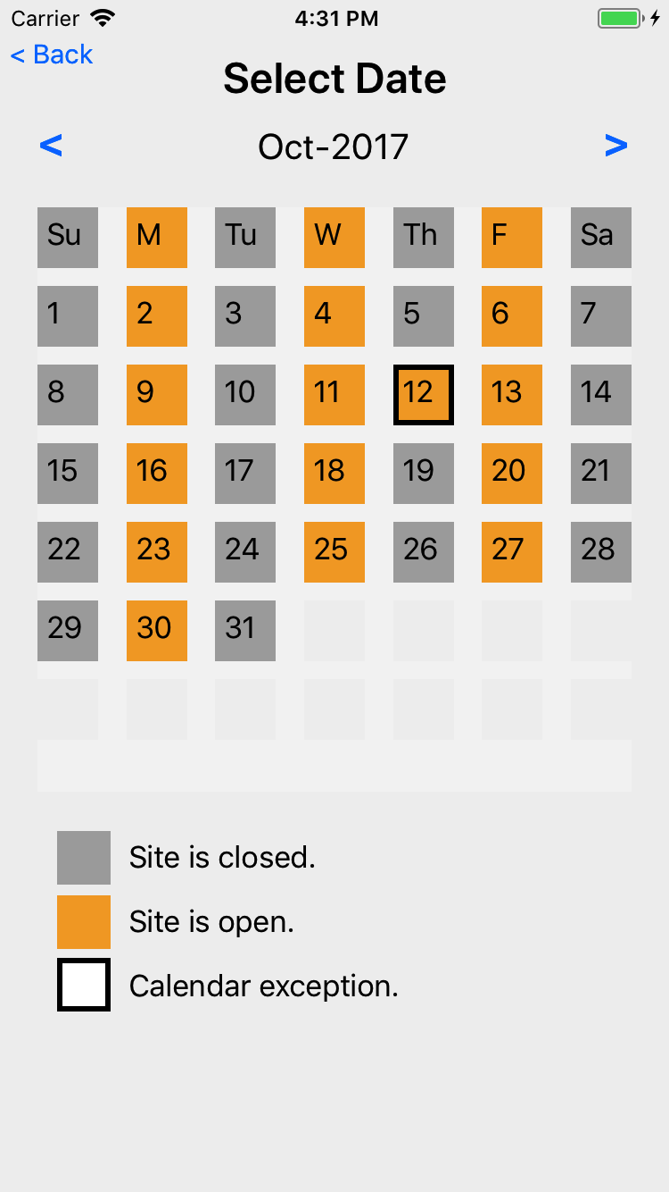
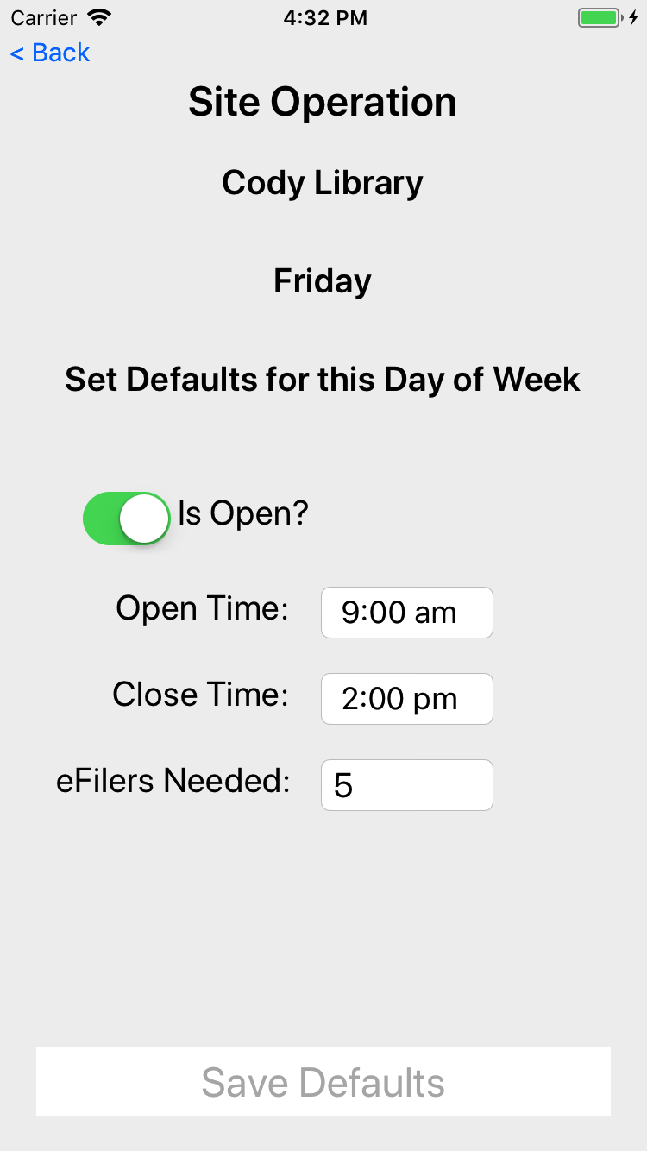
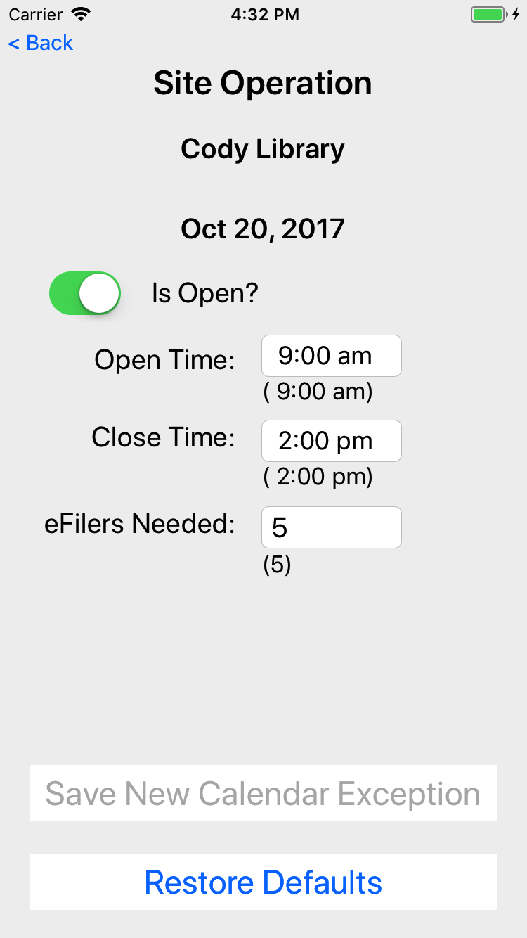
VITA App – Site Coordinators
Select Site
Manage Site
Site Volunteers
Site Calendar

Slide 7
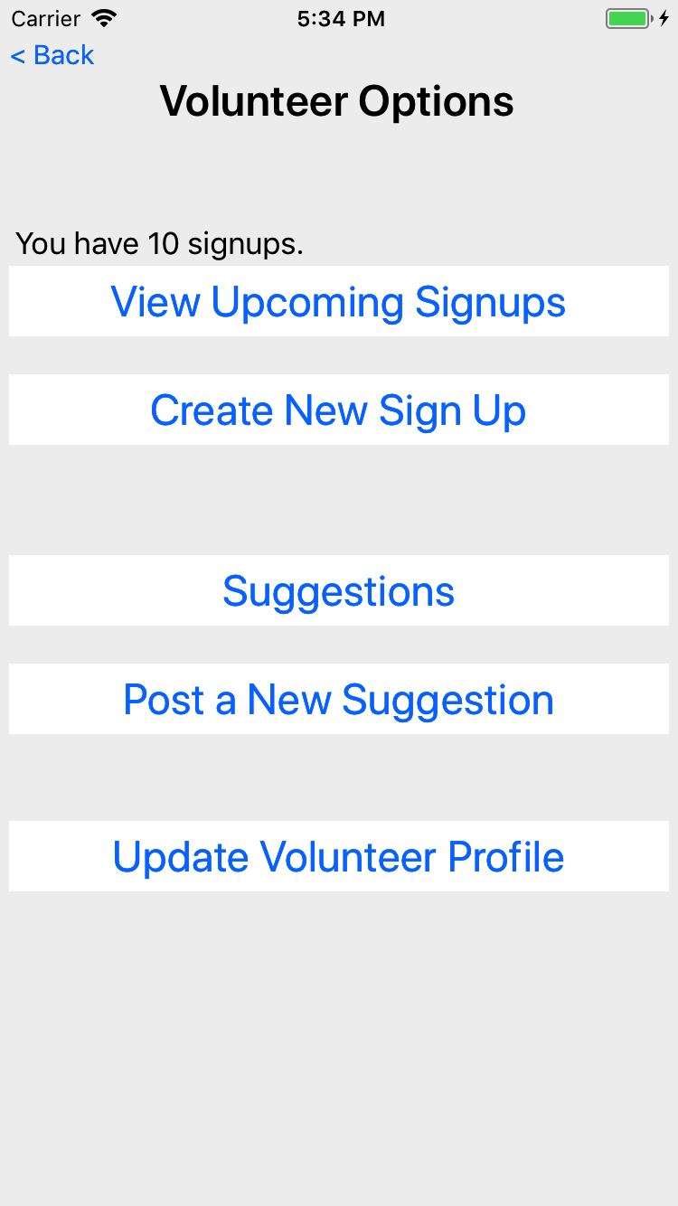
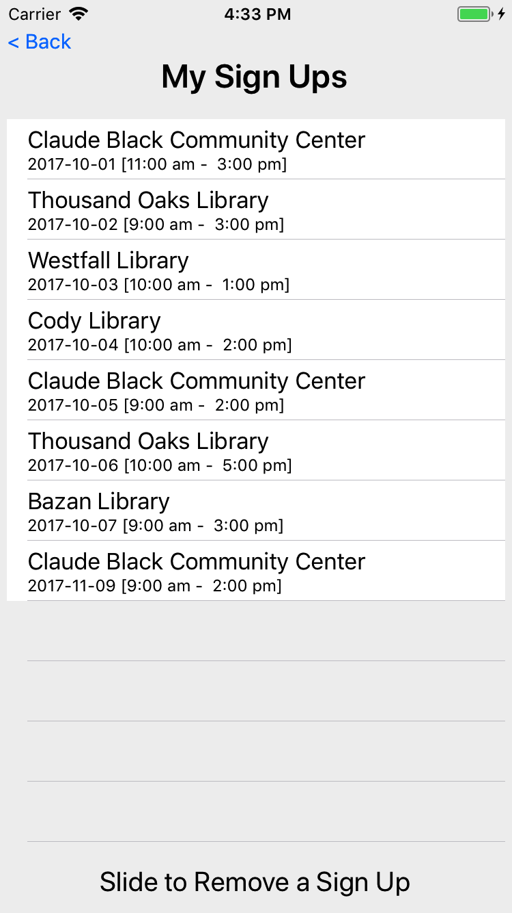
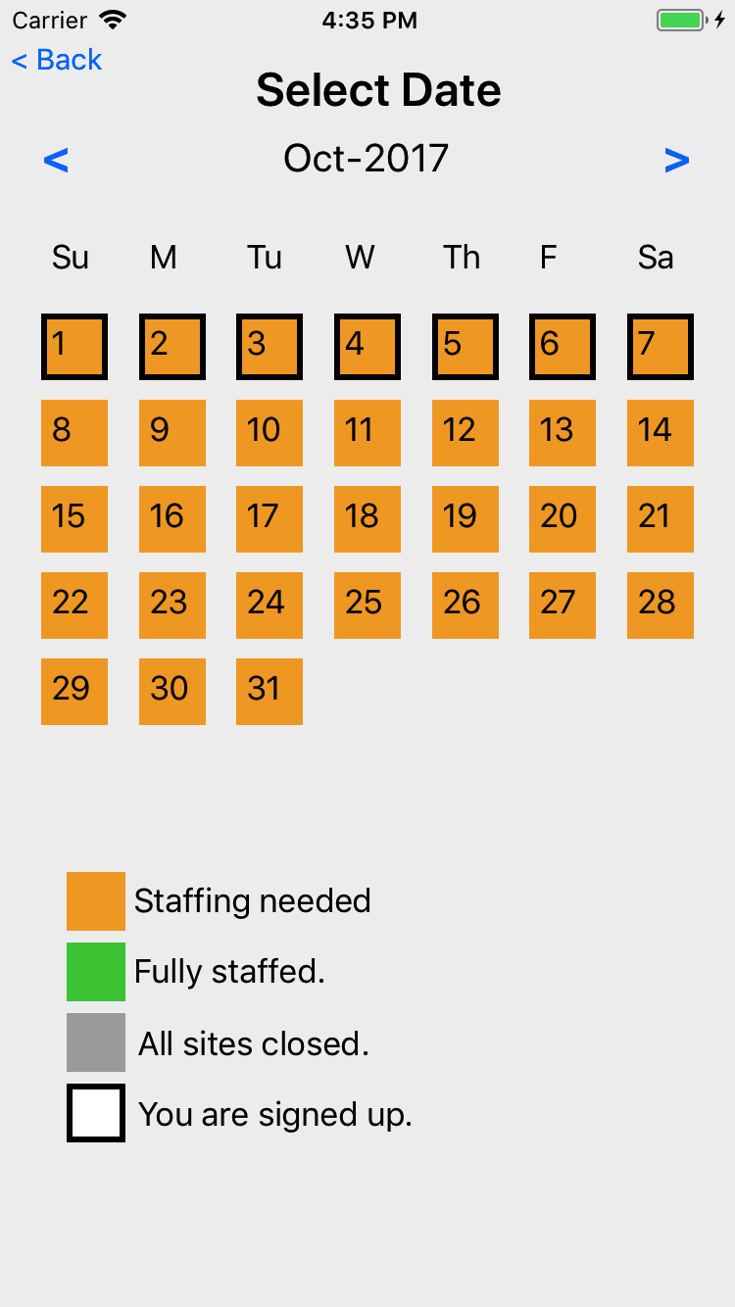
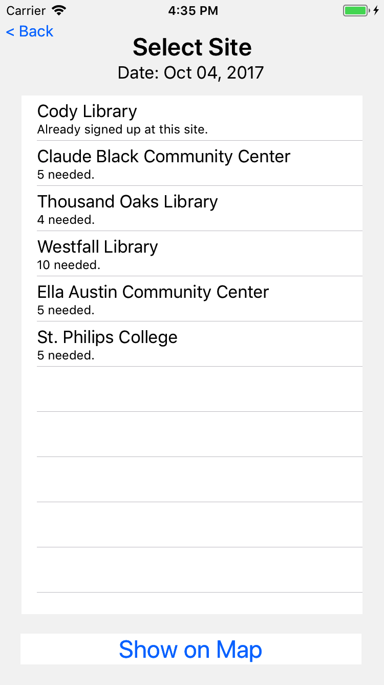
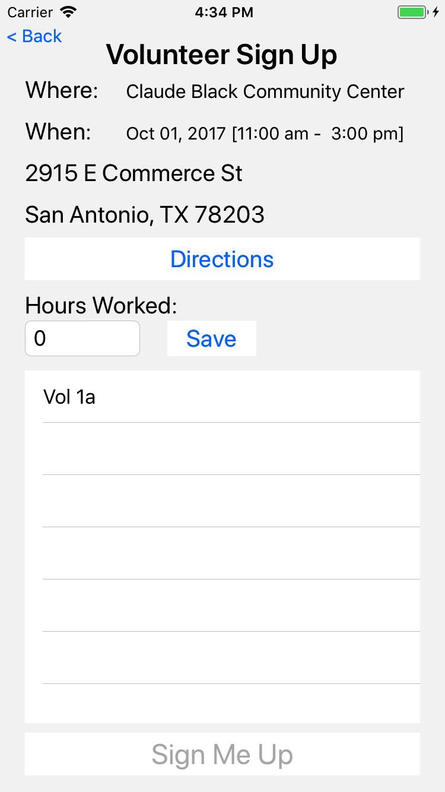
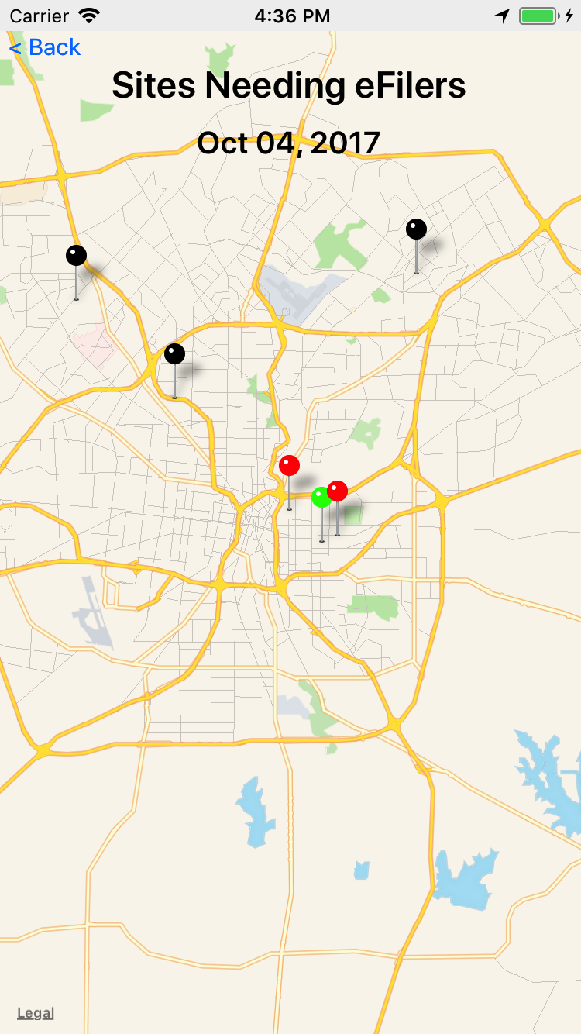
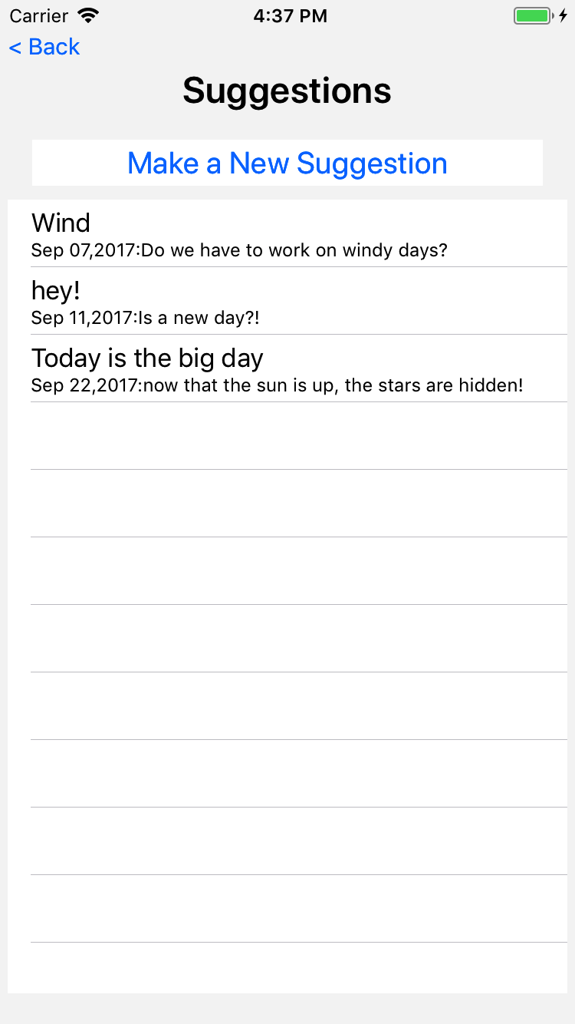
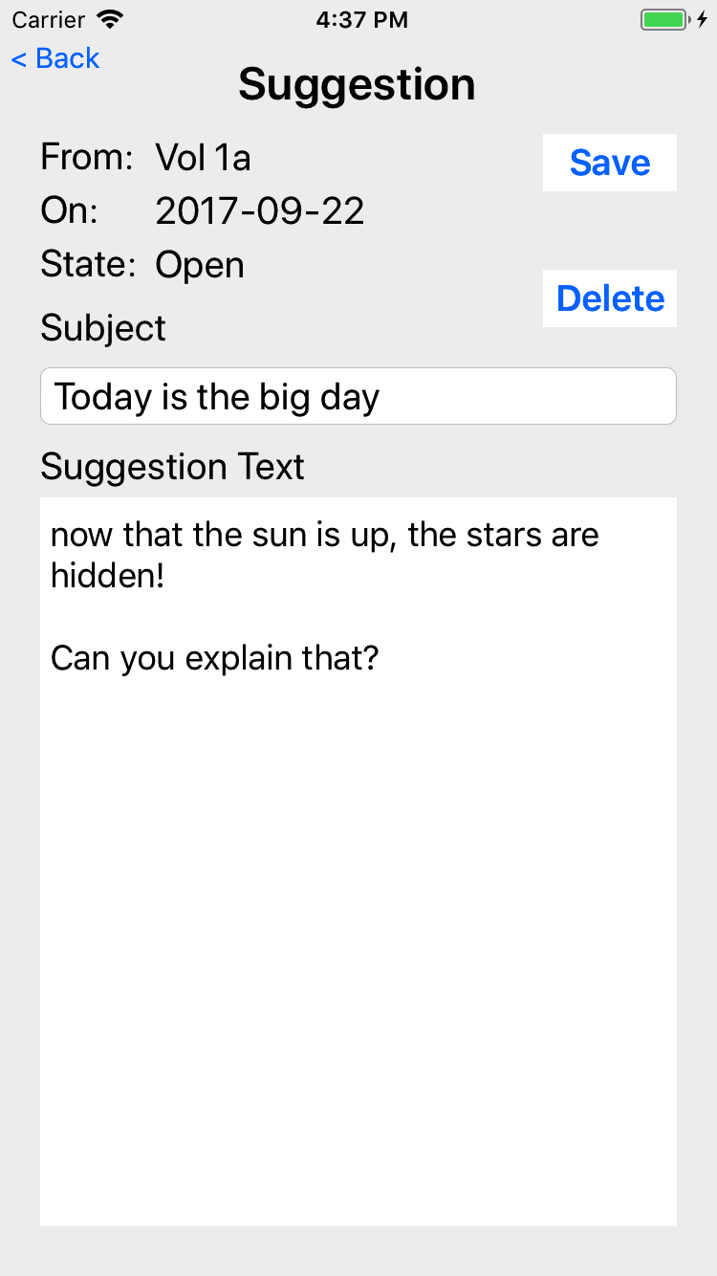
VITA App – Volunteers
Signups
Select Date
View/Confirm
Select Site
Suggestions

Slide 8
Available Materials
Slide deck with speaker notes for Volunteers
Slide deck with speaker notes for Site Coordinators

